Slide 1
Radio Telemetry Data from Muskellunge in Stonewall Jackson Lake
By: Peter Jenkins

Slide 2
Introduction
Lack of research in southern range
High catch rates in summer
Water temperatures in southern range exceed 24C
Low natural and harvest mortality amplifies the impact of catch and release mortality⁶
Notes:
Lack research from south especially on revisors
~ 300 muskellunge reported in 2020 from SJL
24 c = 75 F

Slide 3
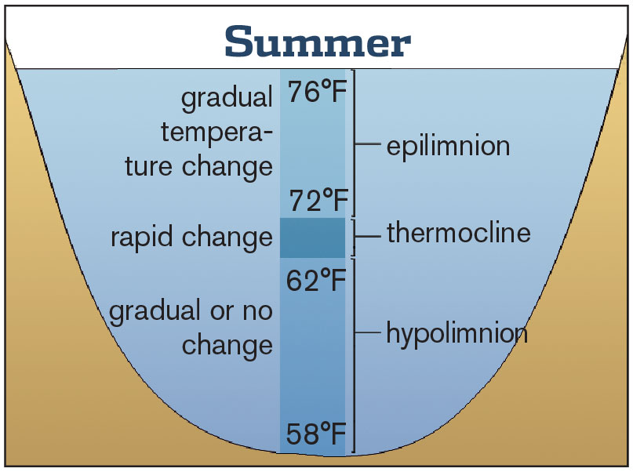
Study Area
Stonewall Jackson Lake
Flood control reservoir
Stocked Population
1072 hectares
https://www.in-fisherman.com/editorial/understanding-the-fall-turnover-period/367619
Notes:
Lake stratification is separated into different temperature and thus density of water, colder more dense water on the bottom, low oxygen. Warm oxygenated water from the sun and wind on top, with thermocline in the middle, sharp temperature and normally DO concentrations.

Slide 4
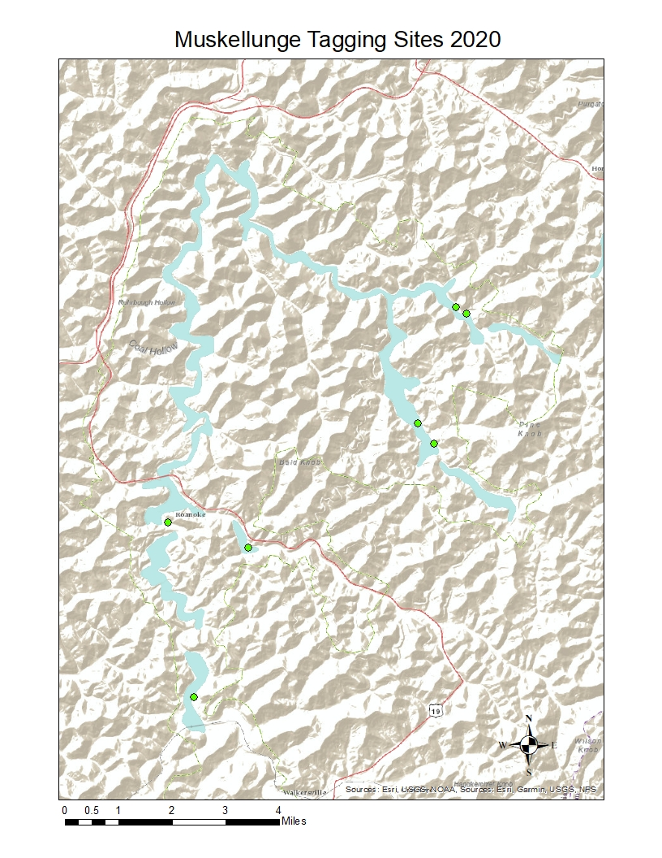
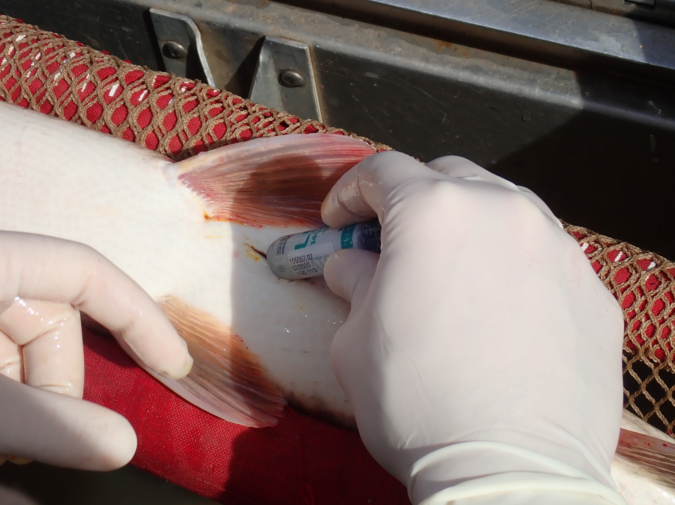
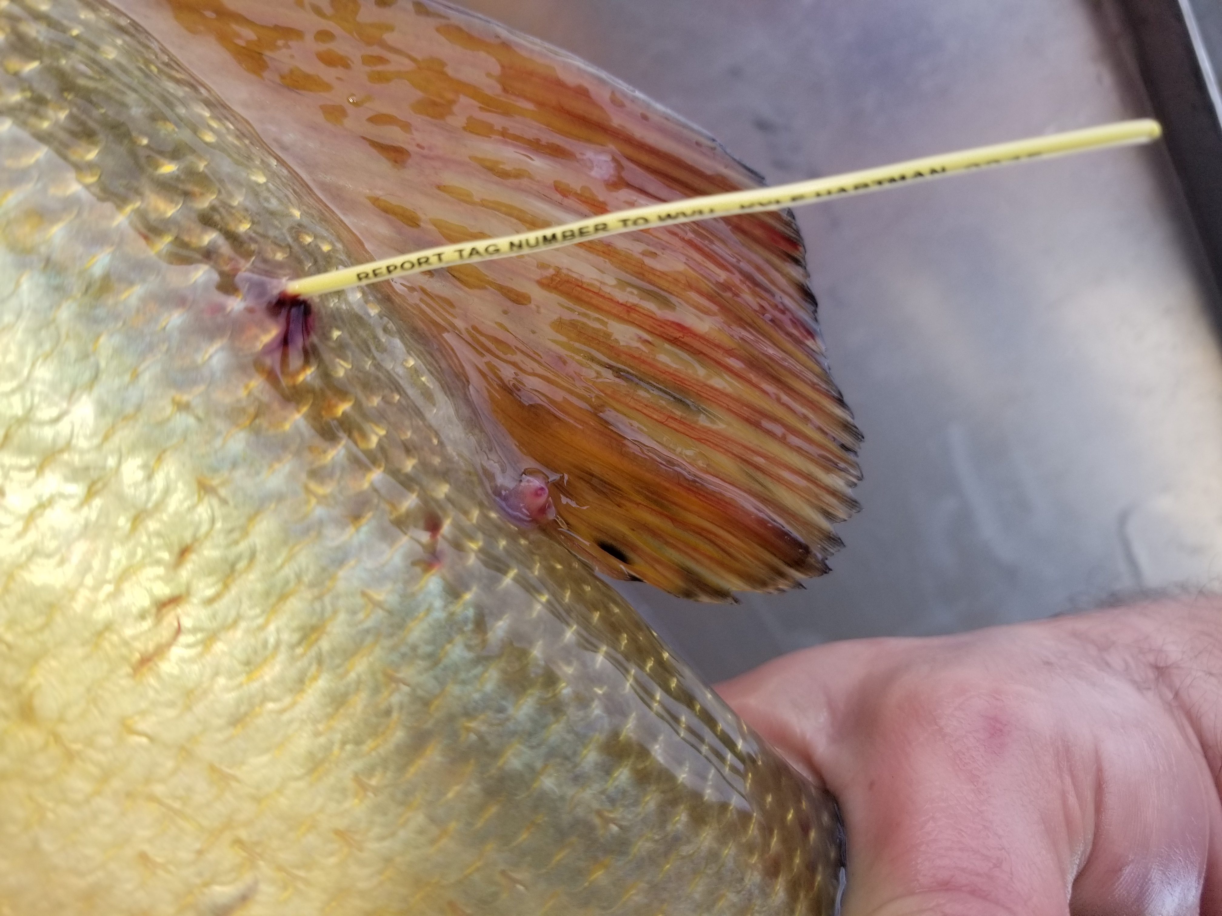
Summary
Electroshocking
45 Muskellunge
Radio telemetry
Dart Tag

Slide 5
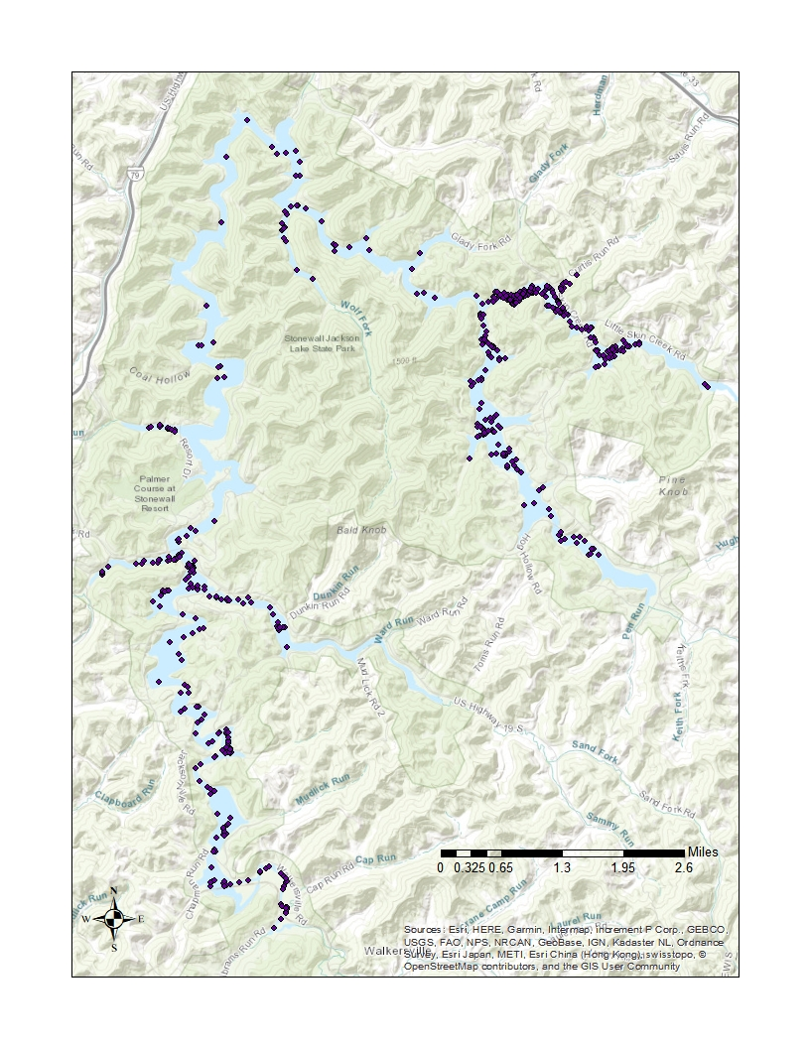
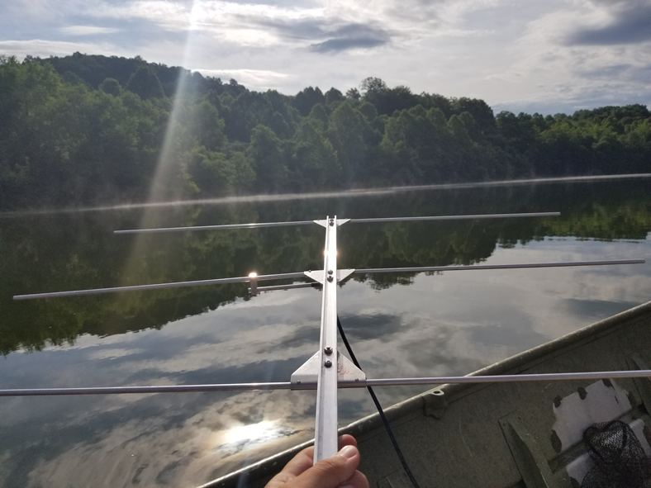
Summary
Weekly Tracking June -September
749 total locations
~ 12 locations per individual
Water Temperature
Dissolved Oxygen Levels
Notes:
On average we located 42 muskellunge each week. Each muskellunge was located an average
119 of 12 times with the lowest number of locations for a single muskellunge being 10 and the
120 highest being 20.

Slide 6
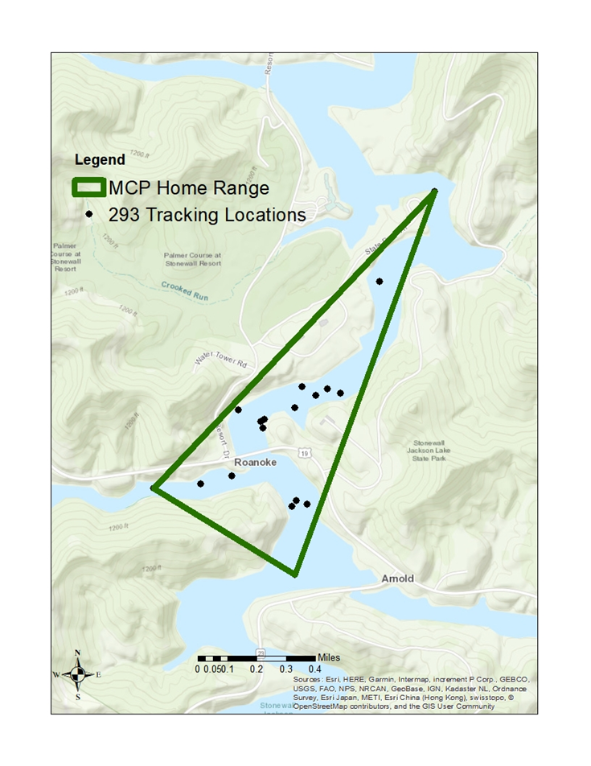
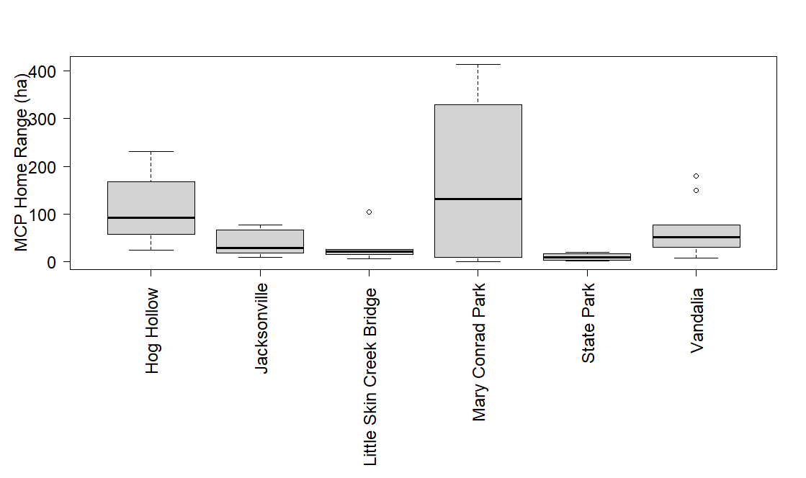
Home ranges
Notes:
Min Convex polygon to estimate home range due to small sample size

Slide 7
Modeling Home Ranges
Gamma model for MCP home ranges
Response variable: home range size
Predictor variables: total length, sex, release location

Slide 8
Models
Model | K | AIC | Delta_AIC
TL | 9 | 437.38 | 0.00
TL +Sex | 8 | 439.05 | 1.68
Release Site | 4 | 441.20 | 3.83
TL + Release Site | 3 | 443.22 | 5.85
TL + Release Site + Sex | 7 | 446.35 | 8.97

Slide 9
Discussion
Total Length + Sex
Increased home range size could result in higher likelihood of angler capture
Home range differ between locations
Habitat differences causing home range differences?

Slide 10



Acknowledgements
West Virginia Division of Natural Resources
Trooper Erik Workman Foundation
Hugh C. Becker Foundation
Muskies Incorporated
Dr. Kyle Hartman
Dr. Stuart Welsh
Jeff Hansbarger
Dr. Derek Crane

Slide 11
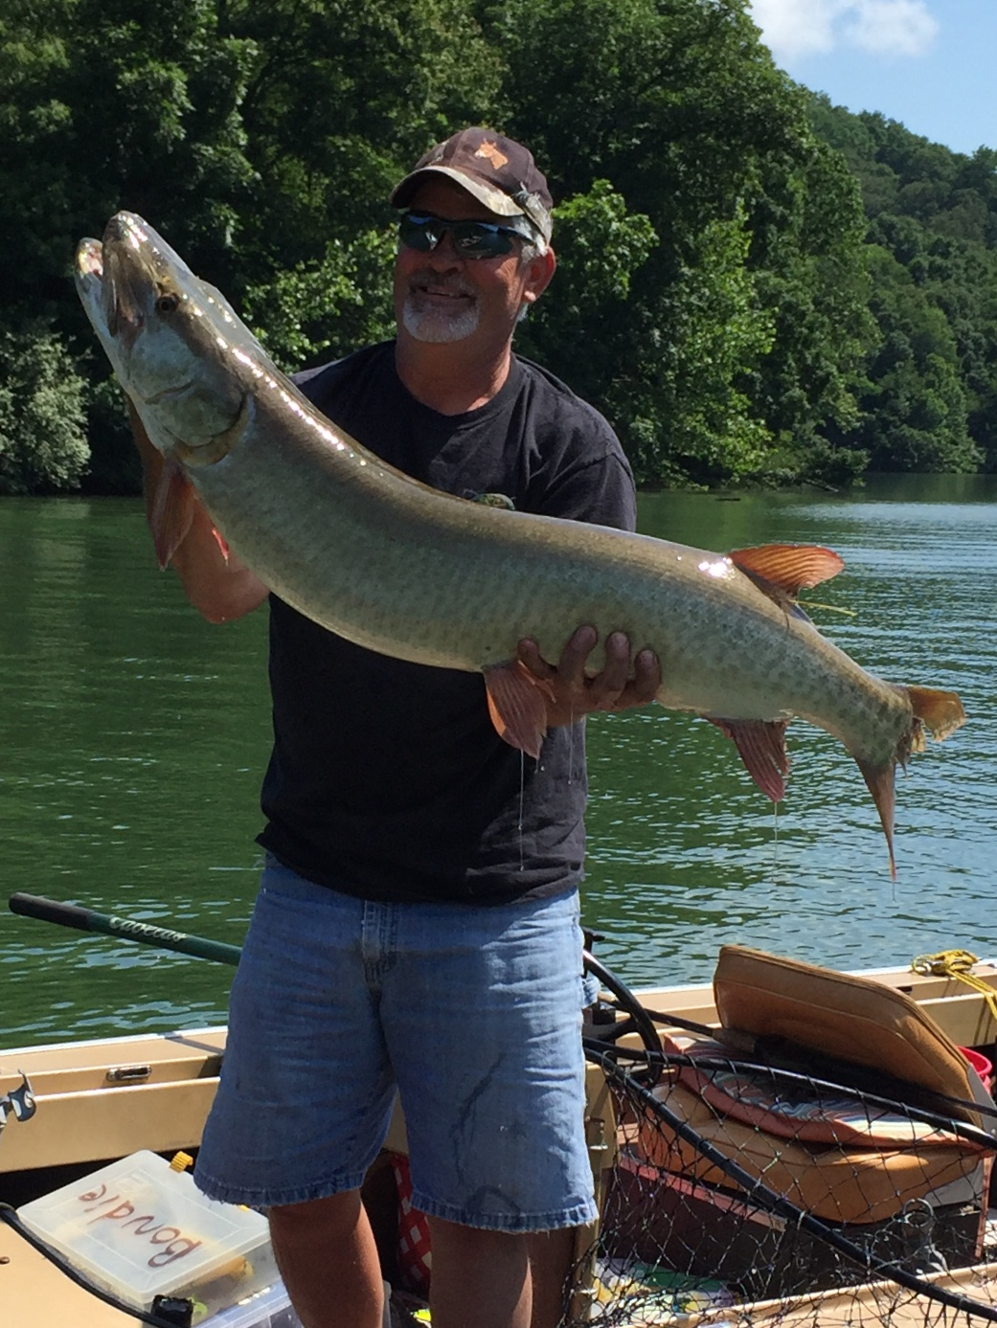
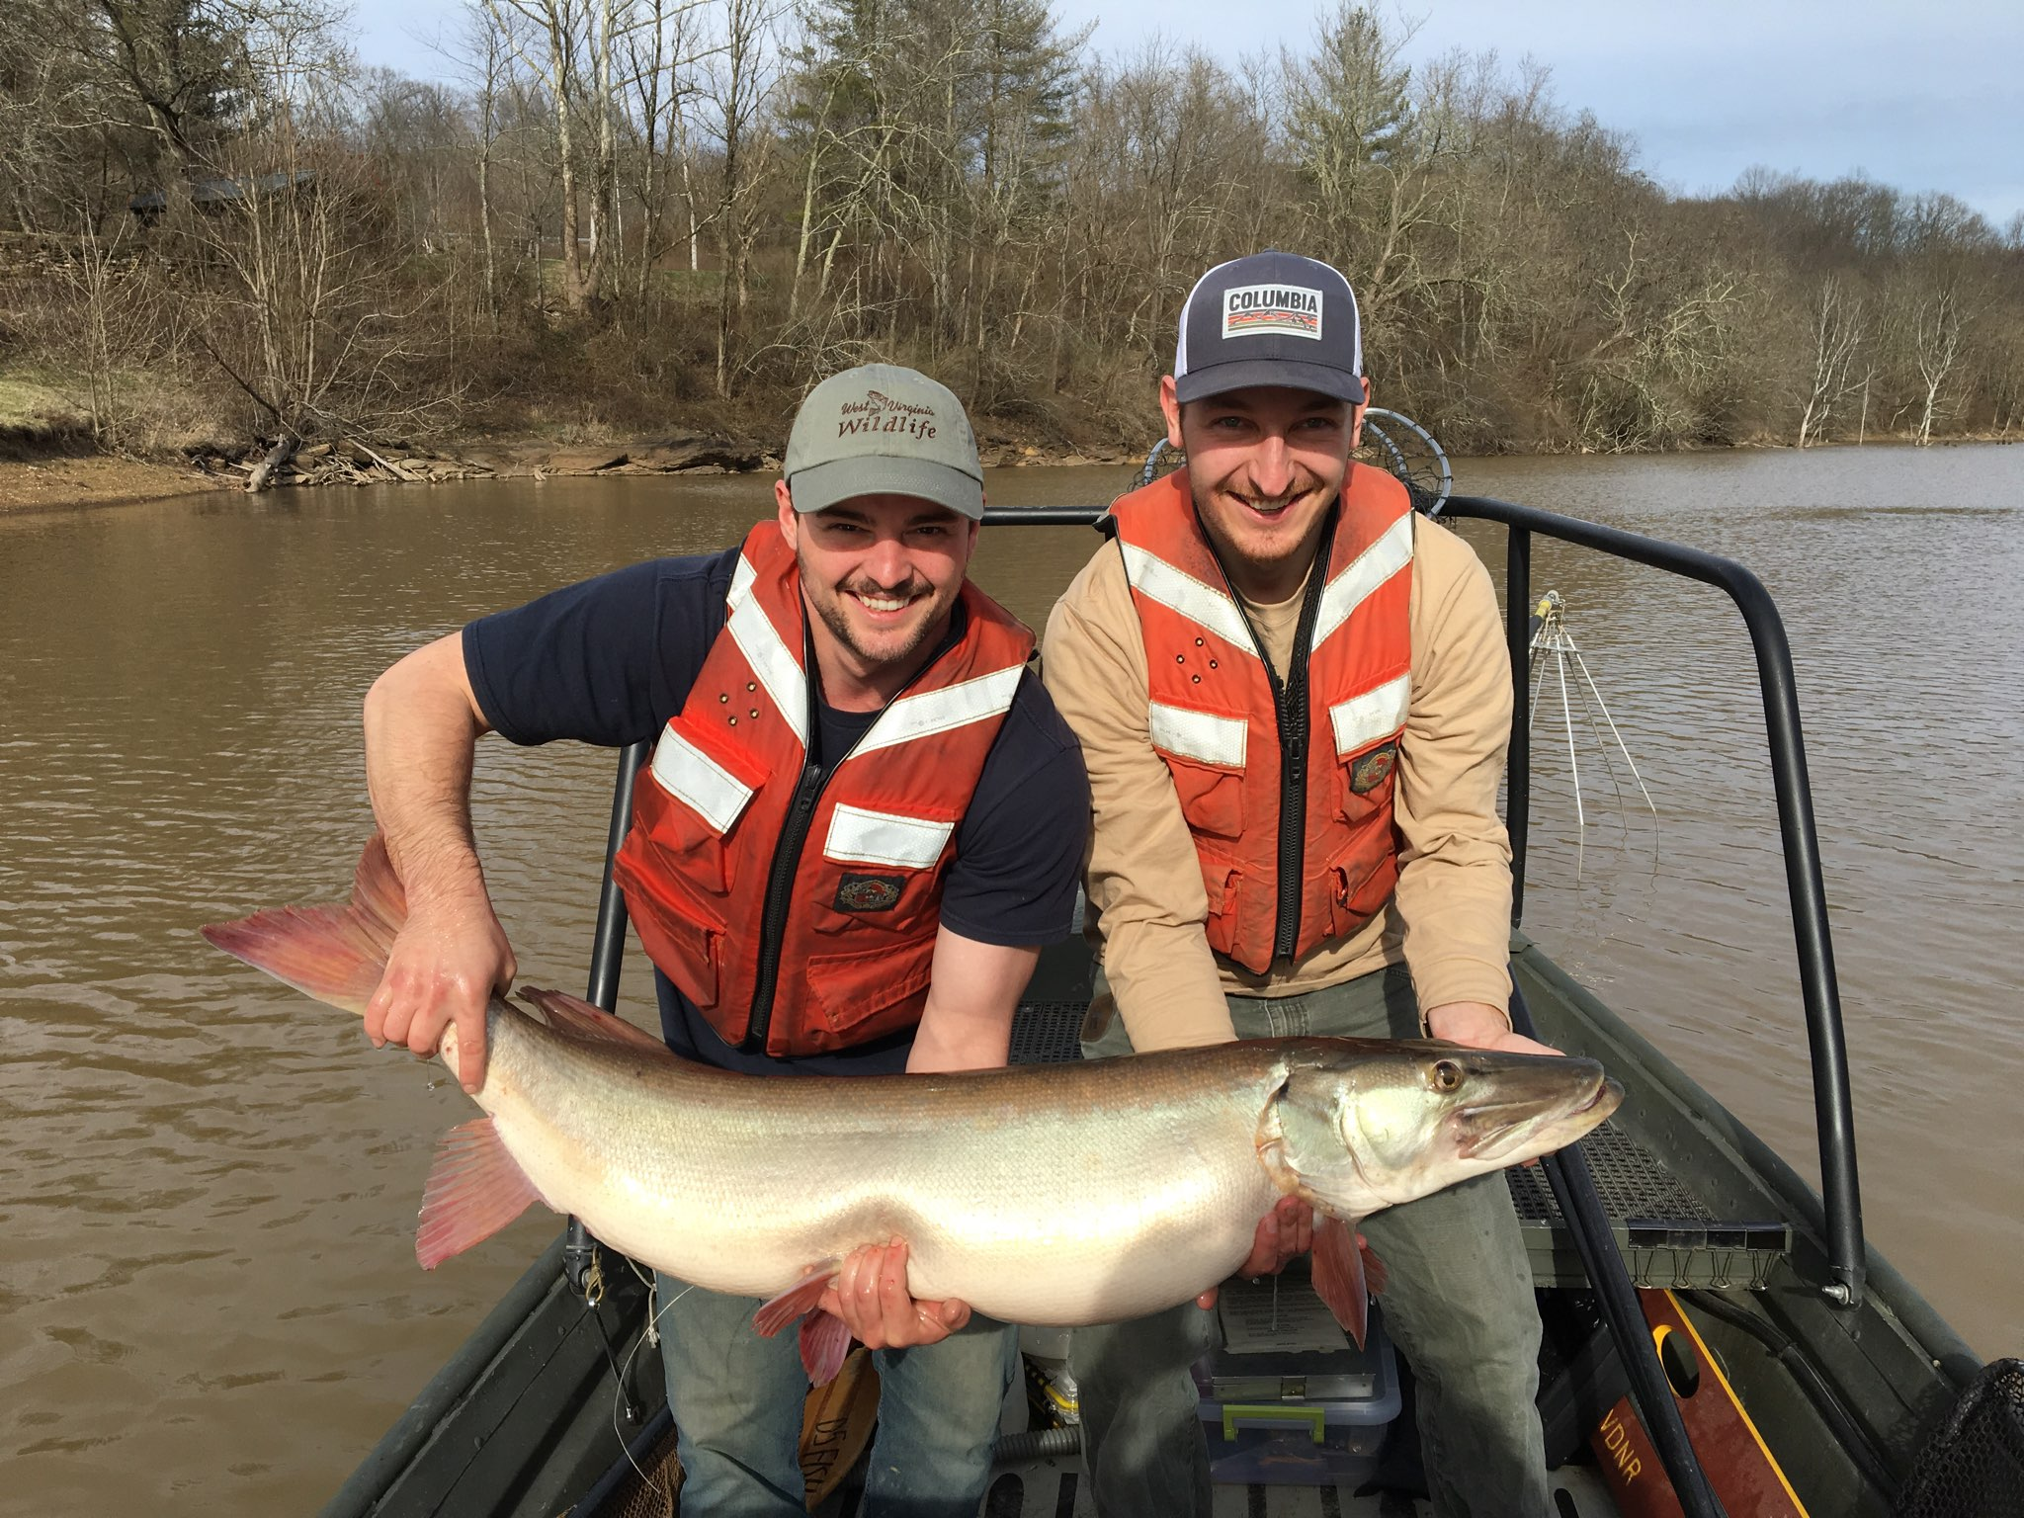
Questions?

